Slide 1
Beyond the Finish Line
A Glance at Formula 1
Presented by: Eric, Rehana, and Fatima

Slide 2
TABLE OF CONTENTS
01
Background
04
Methodology
What is F1, why is F1, who is F1?
The process for cleaning data and discuss joins! Among other things of course.
02
Deeper dive into our data
05
A closer look at Ferrari
Explore dataset
Analyse data for the best team in the world. ( We’ll prove it to you, don’t worry)
03
What made us curious?
06
Limitations & Conclusion
Main question.
Final graphs and findings.

Slide 3
Background

Slide 4
An international racing competition with open-cockpit single-seater cars
Officially established in 1950 — the first World Championship race was the British Grand Prix at Silverstone
"Formula" because it refers to the set of rules all participants' cars must follow
Governed by the FIA (Fédération Internationale de l'Automobile)
Each season, drivers and teams compete in two championships:
The Drivers’ Championship (individual points)
The Constructors’ Championship (team points).

Slide 5
Races are held on 5 continents across 20+ countries — it's one of the most international sports in the world.
Monaco Grand Prix is one of the oldest and most prestigious races, famous for its tight street circuit and glamour.
The F1 calendar shifts every year, but legendary circuits like Silverstone (UK), Monza (Italy), and Spa-Francorchamps (Belgium) have been around for decades.

Slide 6
Evolution and Tech:
In the 1950s-60s, cars were front-engined; later, they moved engines behind the driver (mid-engine), making them much faster.
F1 led to innovations we now see in regular cars — like carbon fiber, hybrid engines, and advanced safety features.
Today’s F1 cars can accelerate from 0–100 km/h (62 mph) in ~2.6 seconds and experience forces up to 6G in corners.

Slide 7
“F1 is not just speed; it’s a sport driven by data at every level.”
FER

Slide 8
2. Deeper Dive into our data

Slide 9
Our data contains:
Circuit (track) information
Constructor (team) details and performance
Driver profiles and championship standings
Race event details (dates, locations, circuits)
Lap-by-lap timing data
Pit stop records and timing
Qualifying session results (Q1, Q2, Q3 times)
Sprint race results (for sprint weekends)
Final race results (driver positions, points, laps)
Race statuses (e.g., finished, accident, mechanical failure)
Season summary information (per year)
Data from: https://www.kaggle.com/datasets/rohanrao/formula-1-world-championship-1950-2020

Slide 10
Packages Used
Data files contain:
circuits
constructor_results
constructor_standings
constructors
driver_standings
drivers
lap_times
pit_stops
qualifying
races
results
seasons
sprint_results
status
library(dplyr) library(ggplot2) library(tidyverse)

Slide 11
3. What made us curious?

Slide 12
What are the key performance trends and factors influencing the current F1 teams?
With a closer look at Ferrari's historical performance. We focus on analysing if qualifying positions have any correlation with finishing positions.

Slide 13
4. Methodology (aka finding answers)

Slide 14
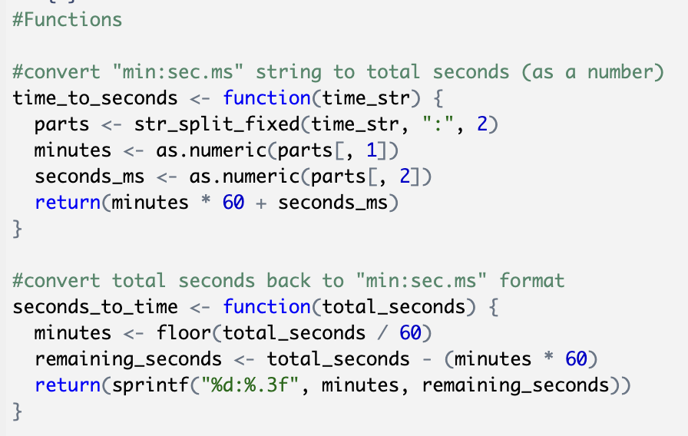
Data cleaning
First we converted our ‘time’ data to that which can be analysed. We created two functions:
Why is that important?
Since we will be working with lap times, converting times to seconds enables us to derive a meaningful metric from the raw qualifying data, which can then be used for various performance evaluations and strategic insights.

Slide 15
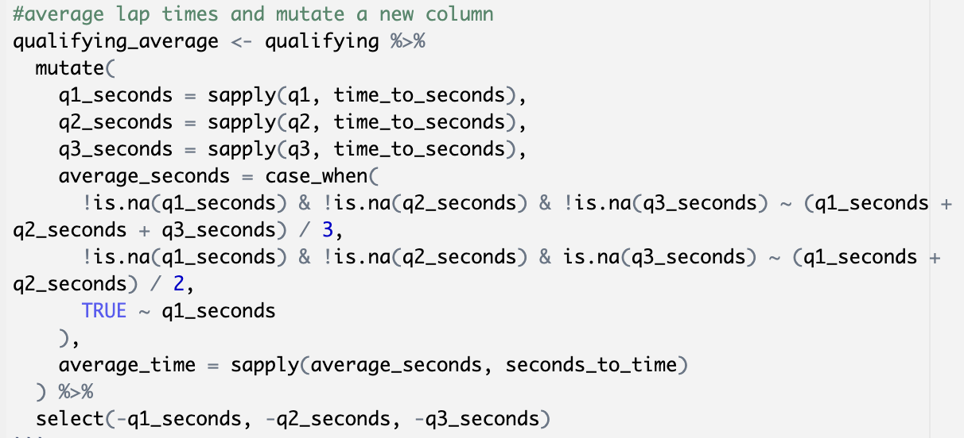
Data cleaning, continued
The average qualifying time provides a concise measure of a driver's performance over the qualifying sessions. It allows for easy comparison of drivers' speeds and consistency.
Next we find the average qualifying lap times.
Why is this important?
The average qualifying time provides a concise measure of a driver's performance over the qualifying sessions. It allows for easy comparison of drivers' speeds and consistency.

Slide 16
JOINS

Slide 17
JOINS
JOINS

Slide 18
JOINS
JOINS
JOINS

Slide 19
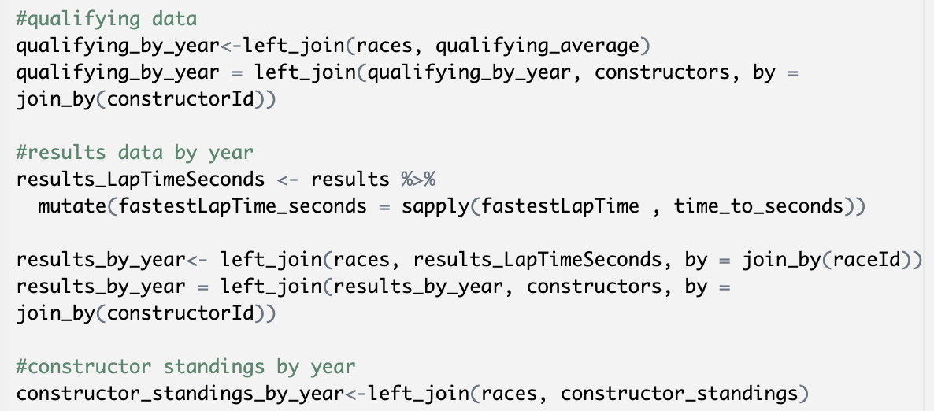
We mainly utilized left_join():
To join race data to other data frames to include year information.

Slide 20

Graph time!

Slide 21
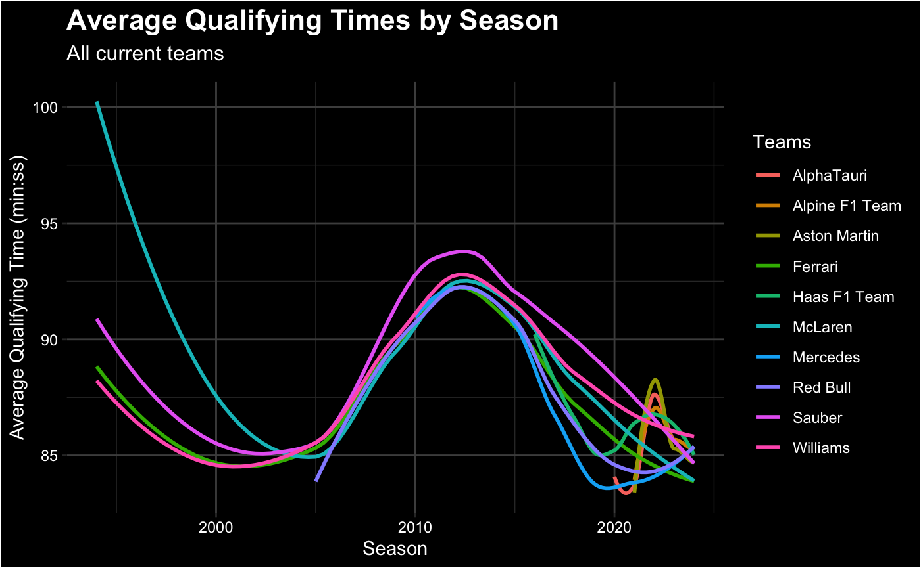
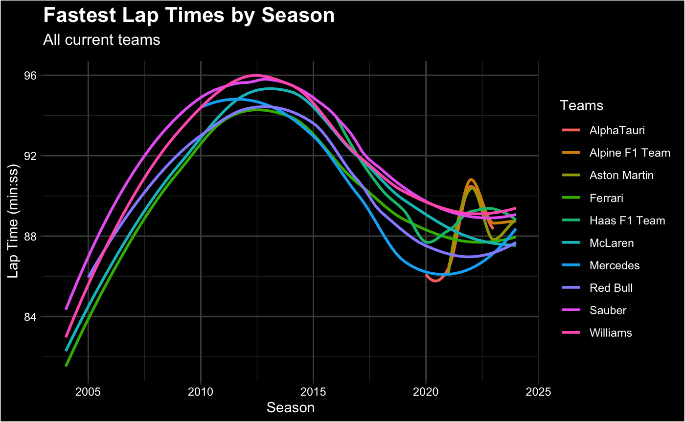
A glance at the Current Teams:
average qualifying time by year
average lap time per year
Notes:
mention the y-axis (the lower the better)

Slide 22
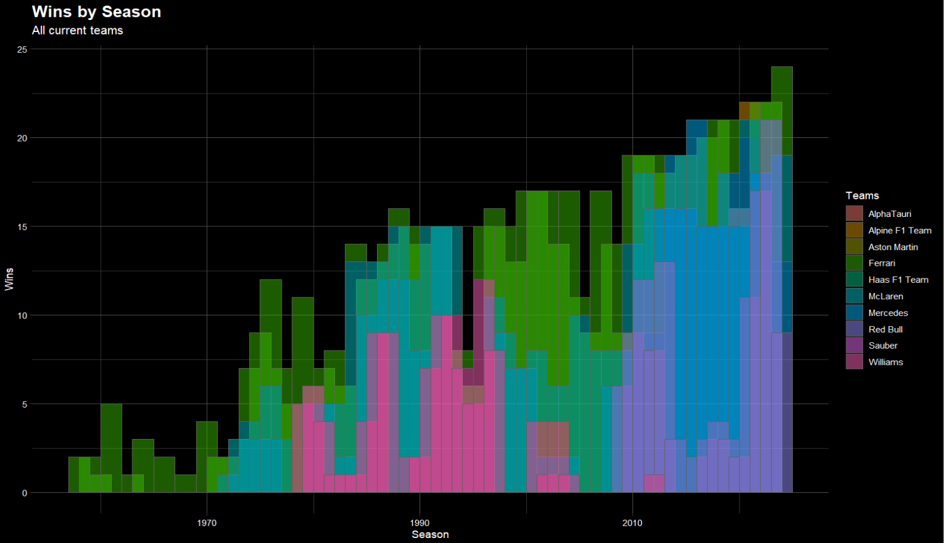

We find:

Slide 23
4. A closer look at Ferrari

Slide 24
Quick facts about Ferrari?
Oldest Team: Racing in F1 since 1950, never missed a season.
Most Constructors' Titles: 16 championships - a record.
Most Famous Drivers: Schumacher, Lauda, Vettel, Leclerc.
Home Turf: Monza, Italy - emotional wins at the Italian Grand Prix.

Slide 25
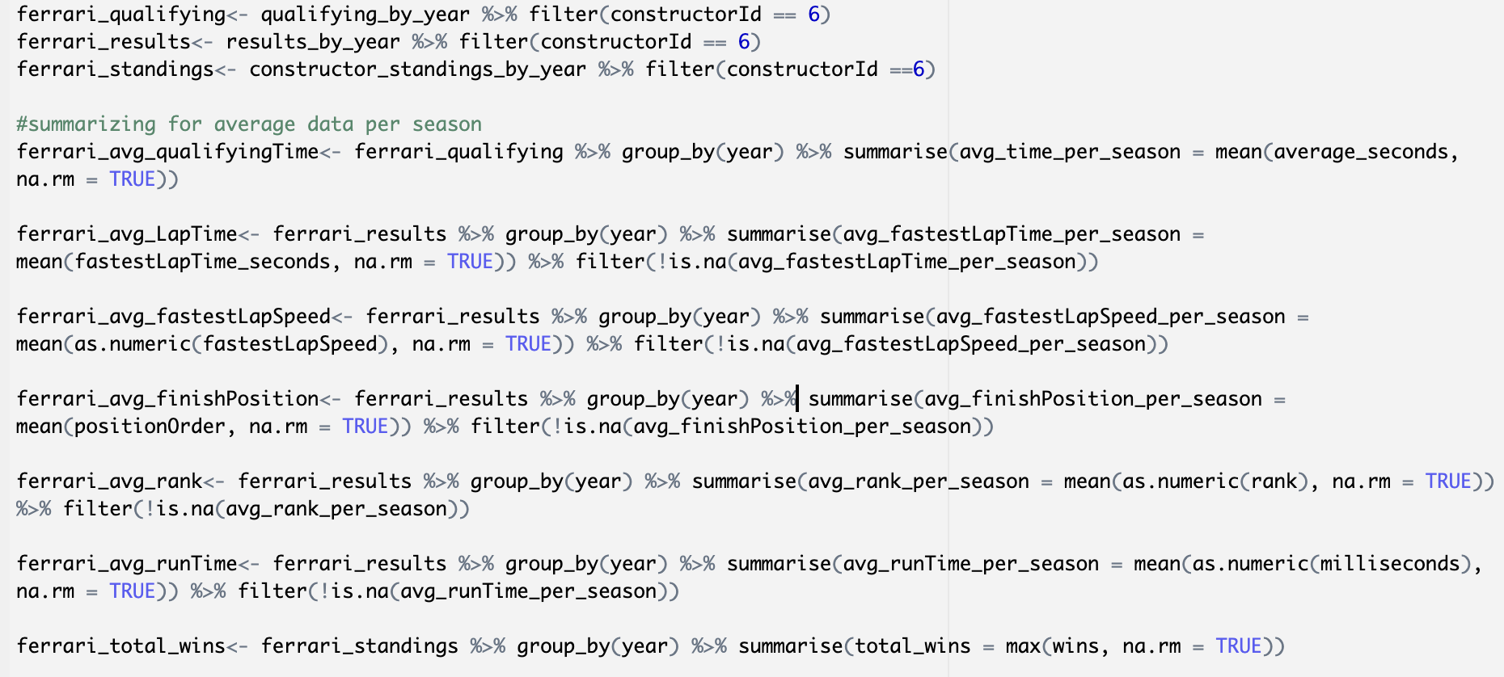
Analysing Ferrari with our data:
First, we filter out Ferrari’s data from all the teams.

Slide 26
We then summarize:
Average qualifying times
Average Lap times
Average of fastest lap times
Average Finish Positions
Average Rank
Averages Run time
Lastly, Total Ferrari wins
Averages for Ferrari over the years.

Slide 27

Graph time!

Slide 28
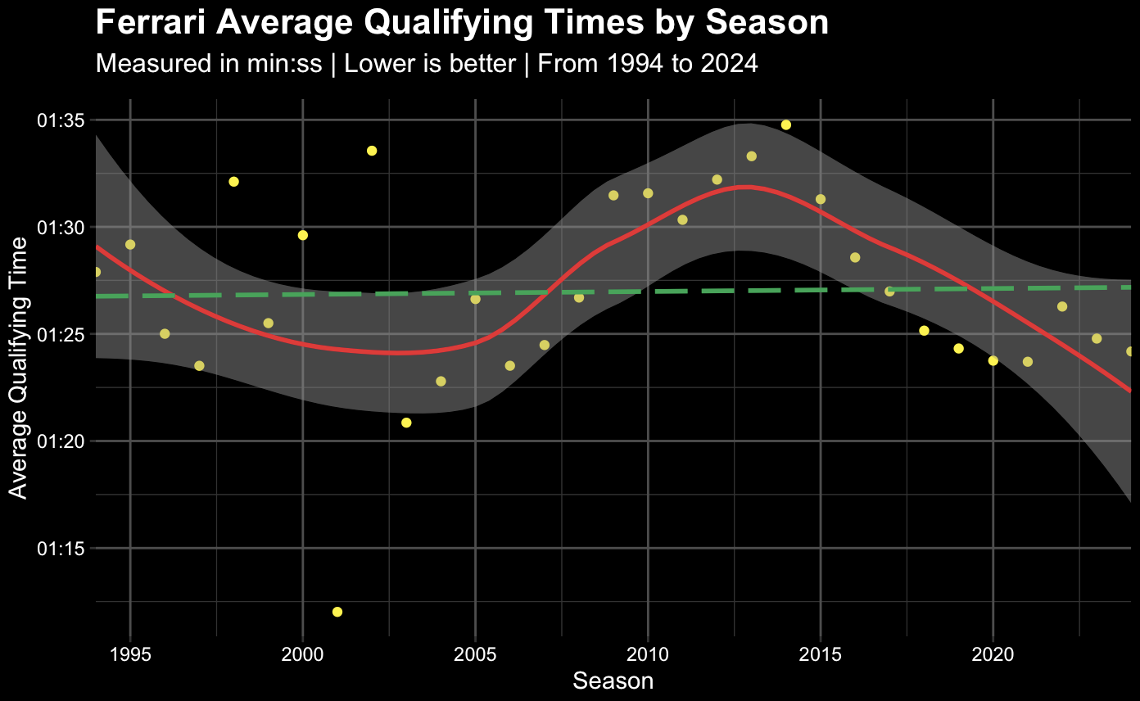

Slide 29
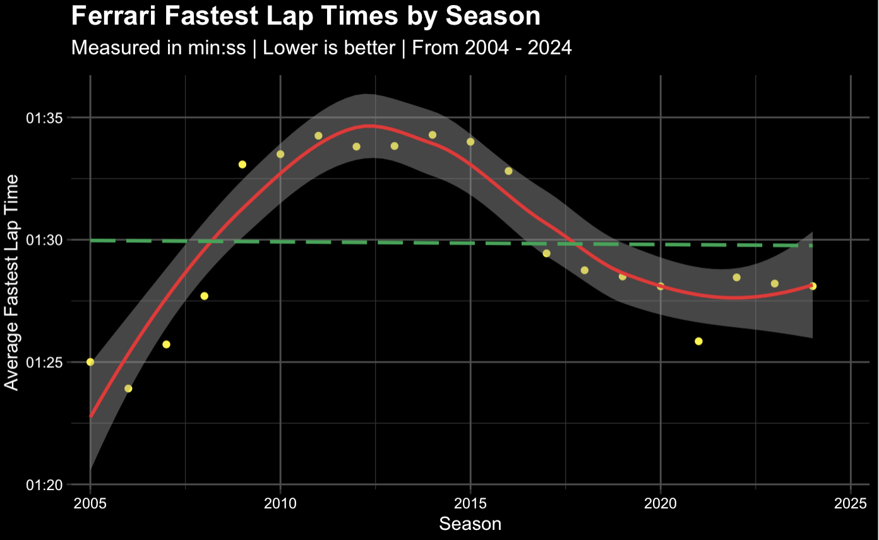
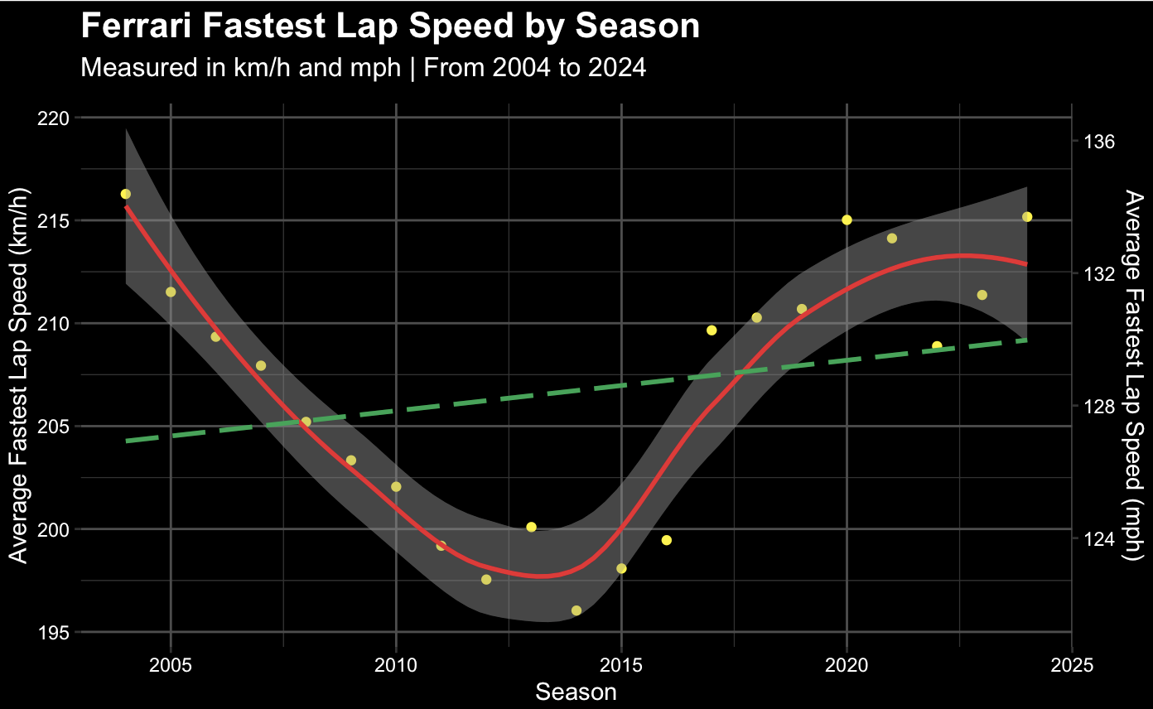

Slide 30
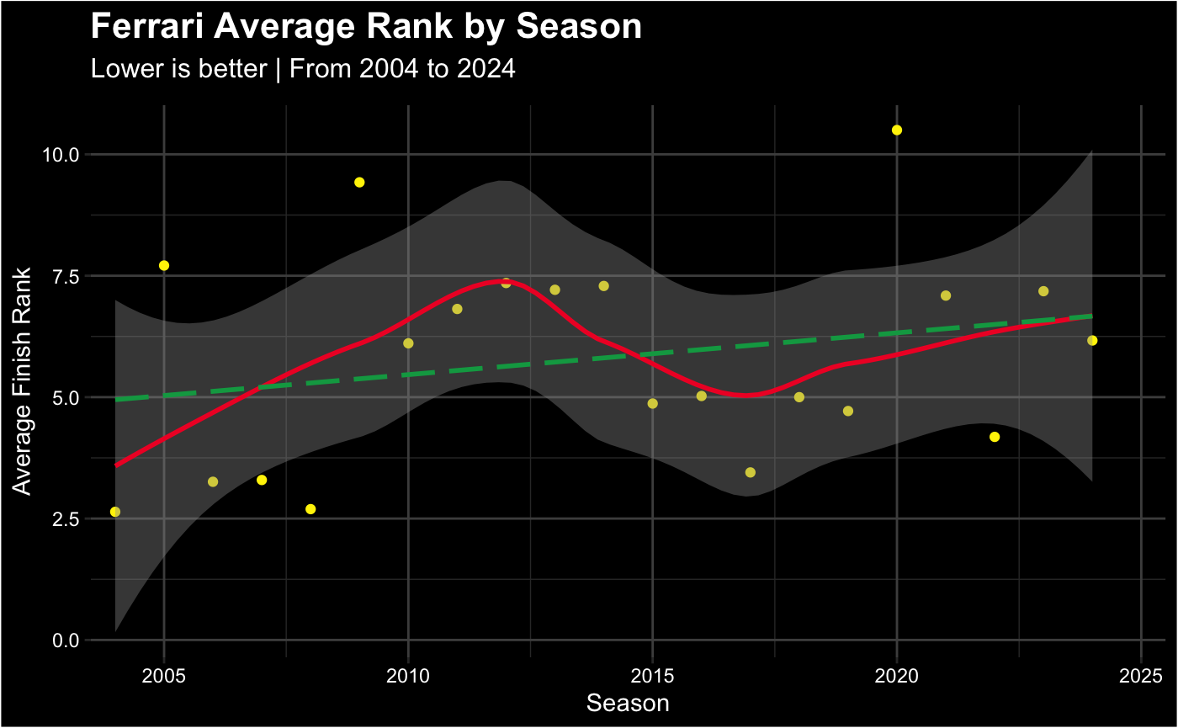

Slide 31
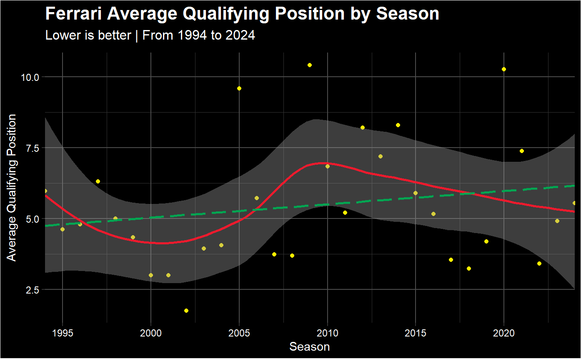

Slide 32
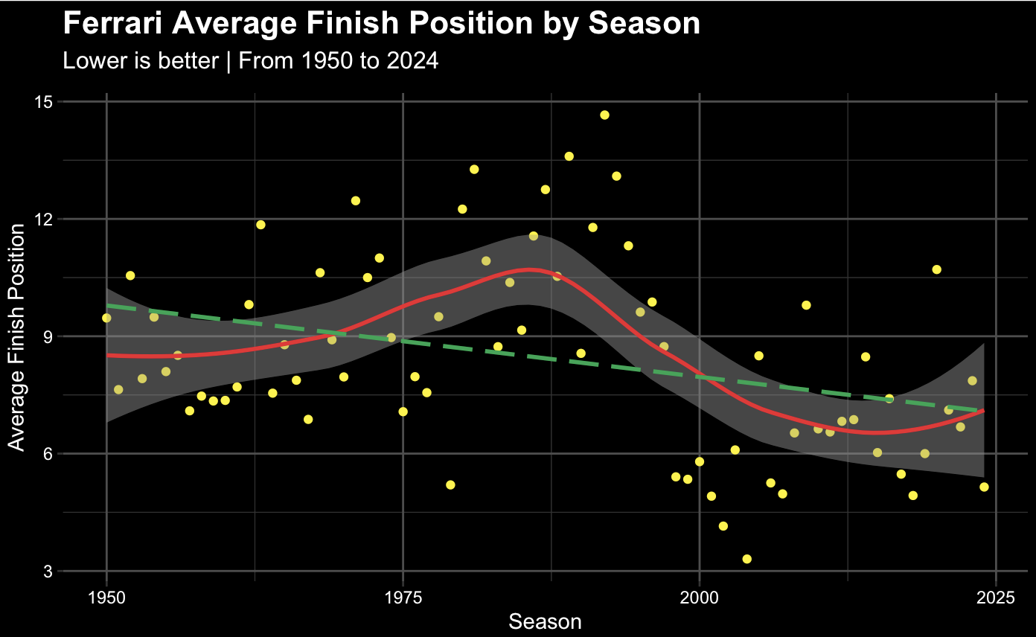

Slide 33
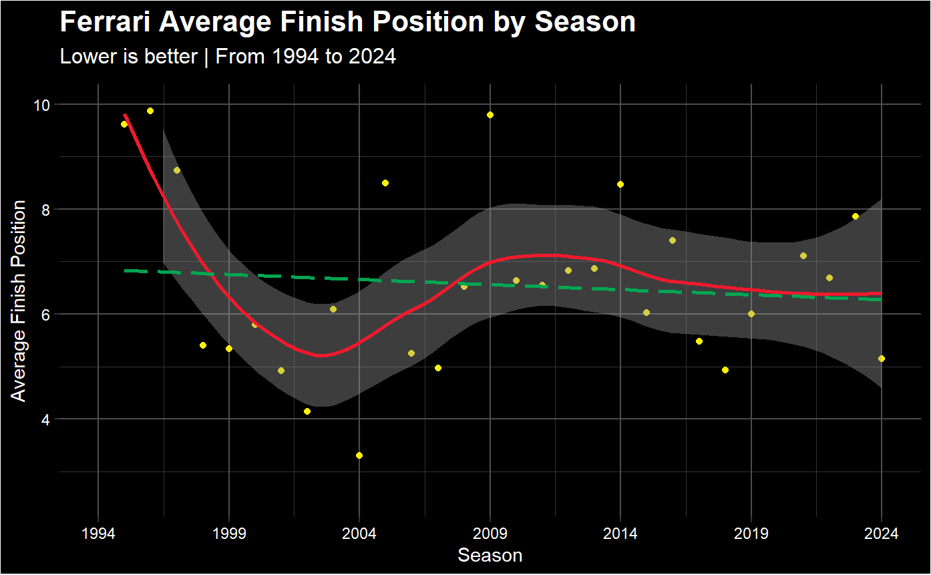

Slide 35
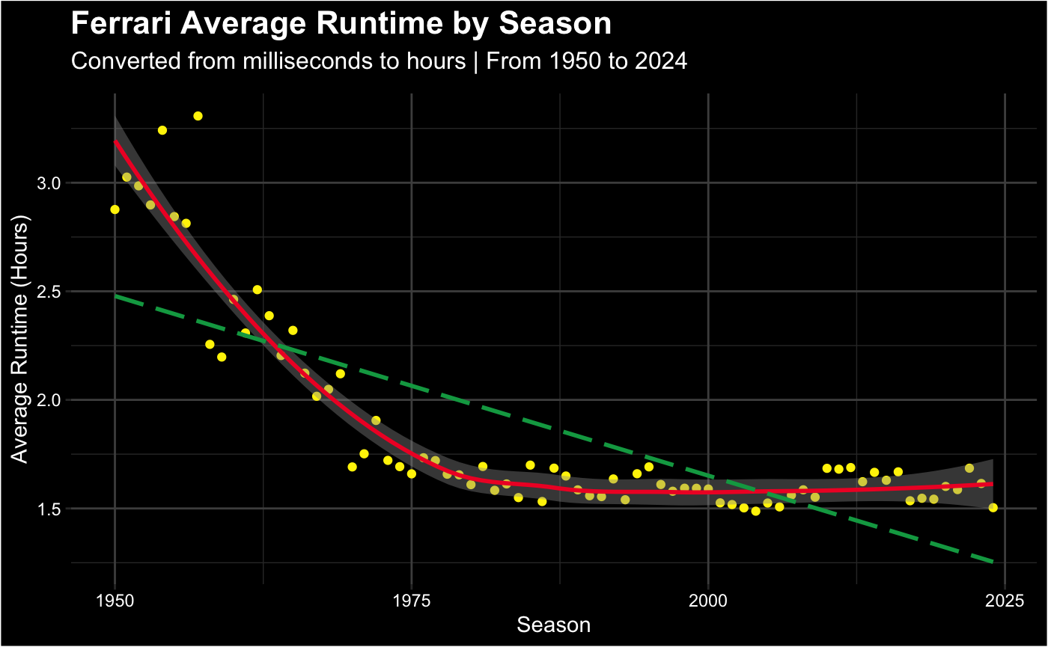

Slide 36
Last but not least…

Slide 37
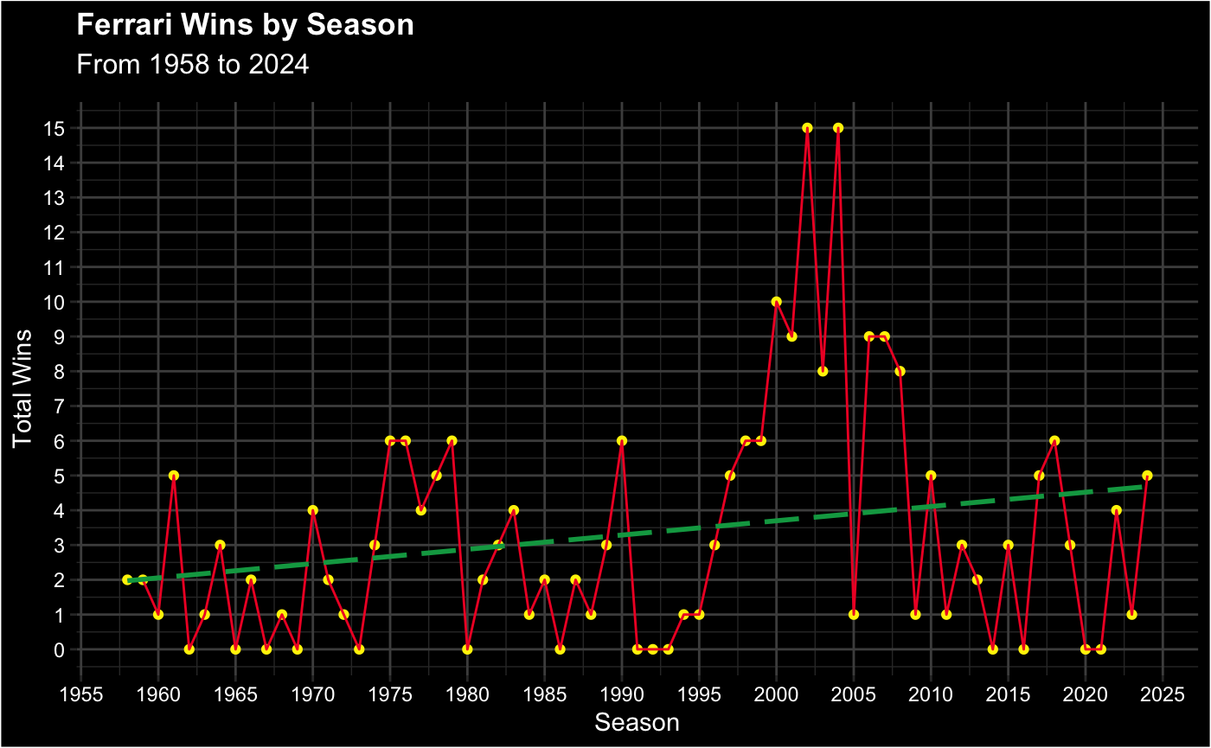

Slide 38


One on One comparison
Is Ferrari really one of the greats??

Slide 39
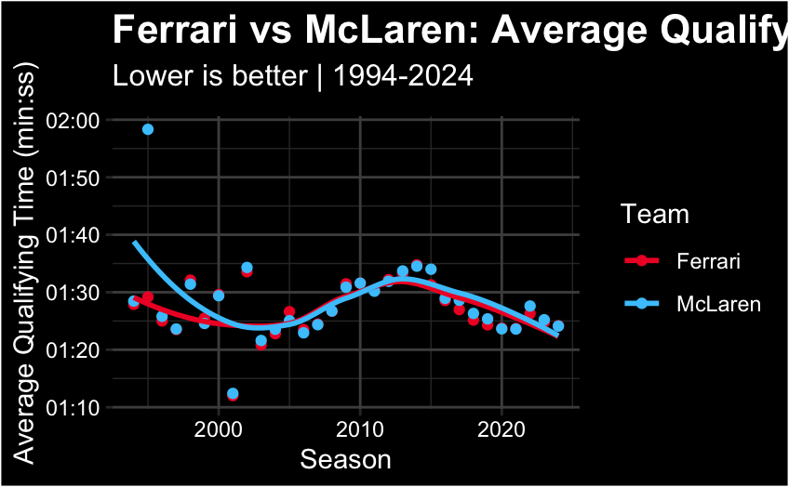
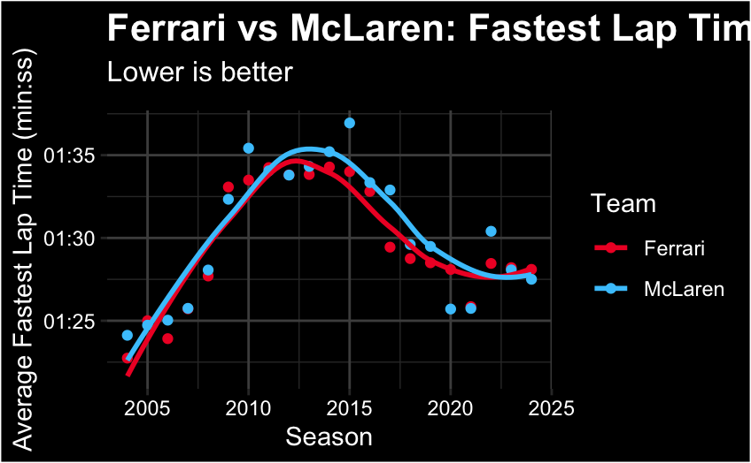
Looking at data from McLaren and Ferrari

Slide 40
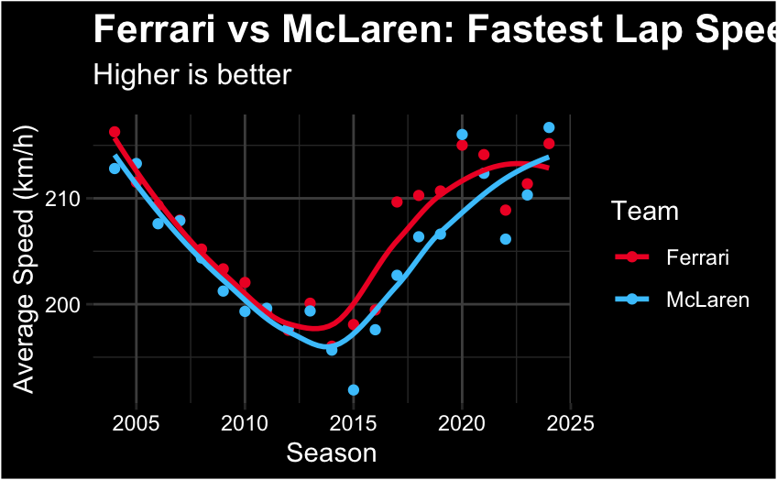
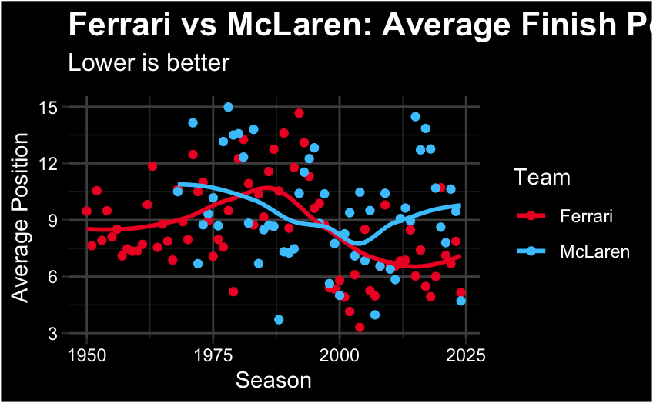
Looking at data from McLaren and Ferrari

Slide 41
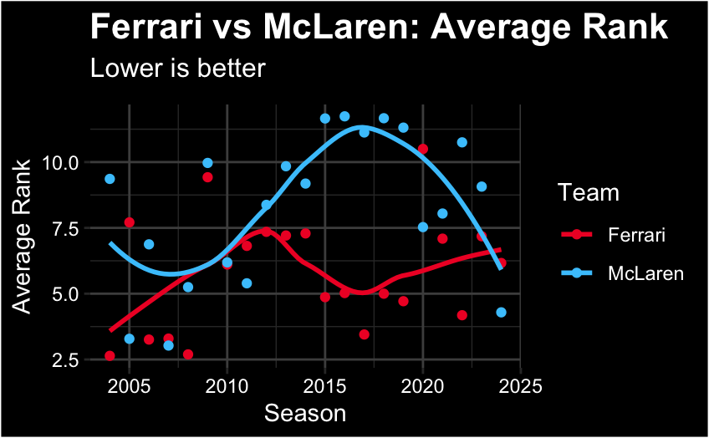
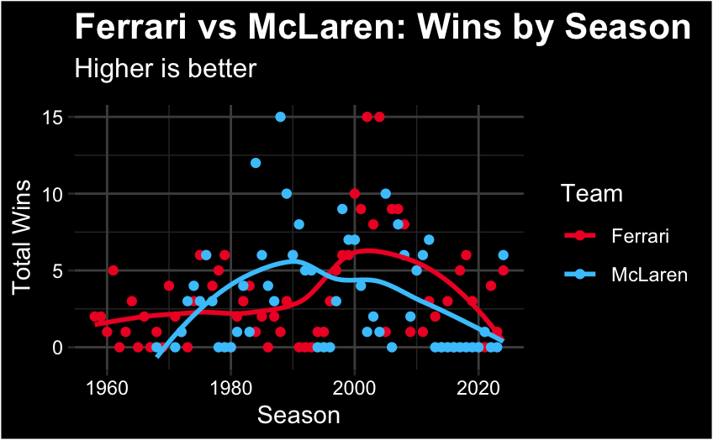
Looking at data from McLaren and Ferrari

Slide 42
Limitations and Conclusion

Slide 43
It would have been nice if we found data regarding…
specific detailed car data (e.g., power unit, aerodynamics) were not available.
Budgetary differences, driver skill, and in-race strategies, which heavily influence race outcomes, were not modeled quantitatively.
"Races are won at the track. Championships are won at the factory." - Mercedes (2019)

Slide 44
In this project, we analyzed Formula 1 performance trends with a special focus on current teams and a deep dive into Ferrari’s historic performance.
Key findings:
Current grid overview: Teams like Red Bull, Ferrari, and Mercedes consistently show strong qualifying and race performance.
The gap between top teams remains clear when comparing qualifying times, fastest laps, and race wins over time.

Slide 45
Ferrari deep dive:
Ferrari remains one of the most historically consistent and successful teams in Formula 1.
Average qualifying times and fastest lap performances show clear periods of dominance, notably in the early 2000s and mid-2010s.
Win counts and finish positions suggest that while Ferrari has experienced fluctuations, they maintain a top-tier presence across decades.
Even during seasons with fewer wins, Ferrari’s fastest lap speeds and runtime efficiency remained competitive, demonstrating that Ferrari is almost always "in the fight," even if they don’t always win championships.

Slide 46
Overall trend: Ferrari’s legacy is characterized by resilience — adapting to changes in car regulations, competitive pressure, and internal challenges — and still remaining a symbol of excellence and passion in Formula 1.
This analysis highlights not only who has been winning in Formula 1 but why teams like Ferrari endure as iconic names in motorsport: a combination of strong qualifying, consistent race performance, technological evolution, and a culture of persistence.
As F1 continues to evolve, it will be fascinating to see if Ferrari’s trends continue upward with upcoming regulation changes.

Slide 47
Thank you!
We hope we inspired you to start watching the sport!

